Slide 1
Radiometric Normalization on Remote Sensing Images
Yanlei Feng
Reasons why the radiance of a given target yields different satellite image data on different dates: 1. Satellite sensor; 2. Observation angles;
Atmospheric effects;
Real changes;
The goal of radiometric correction is to remove or compensate for all the above effects except for actual changes to be on a common scale
(Du, Teillet, and Cihlar, 2002)
Notes:
in ground target to retrieve surface reflectances (absolute correction) or to normalize the digital counts obtained under the different conditions to be on a common scale (relative correction).

Slide 2
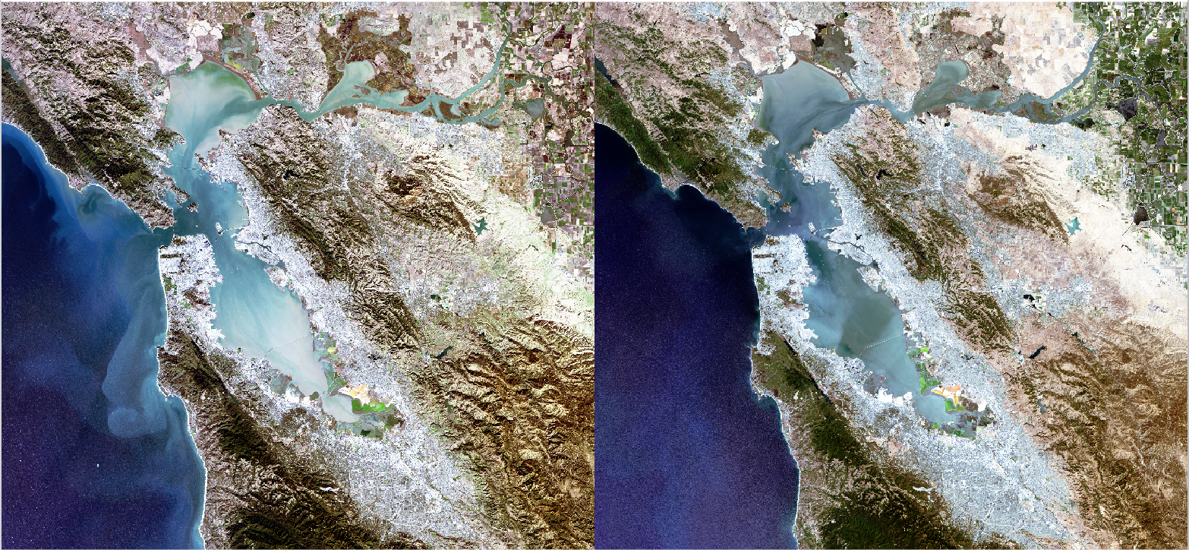
Invariant Targets
Base Image: Landsat 8 TOA, 2015-11-16
Target Image: Landsat 8 TOA, 2015-07-27

Slide 3
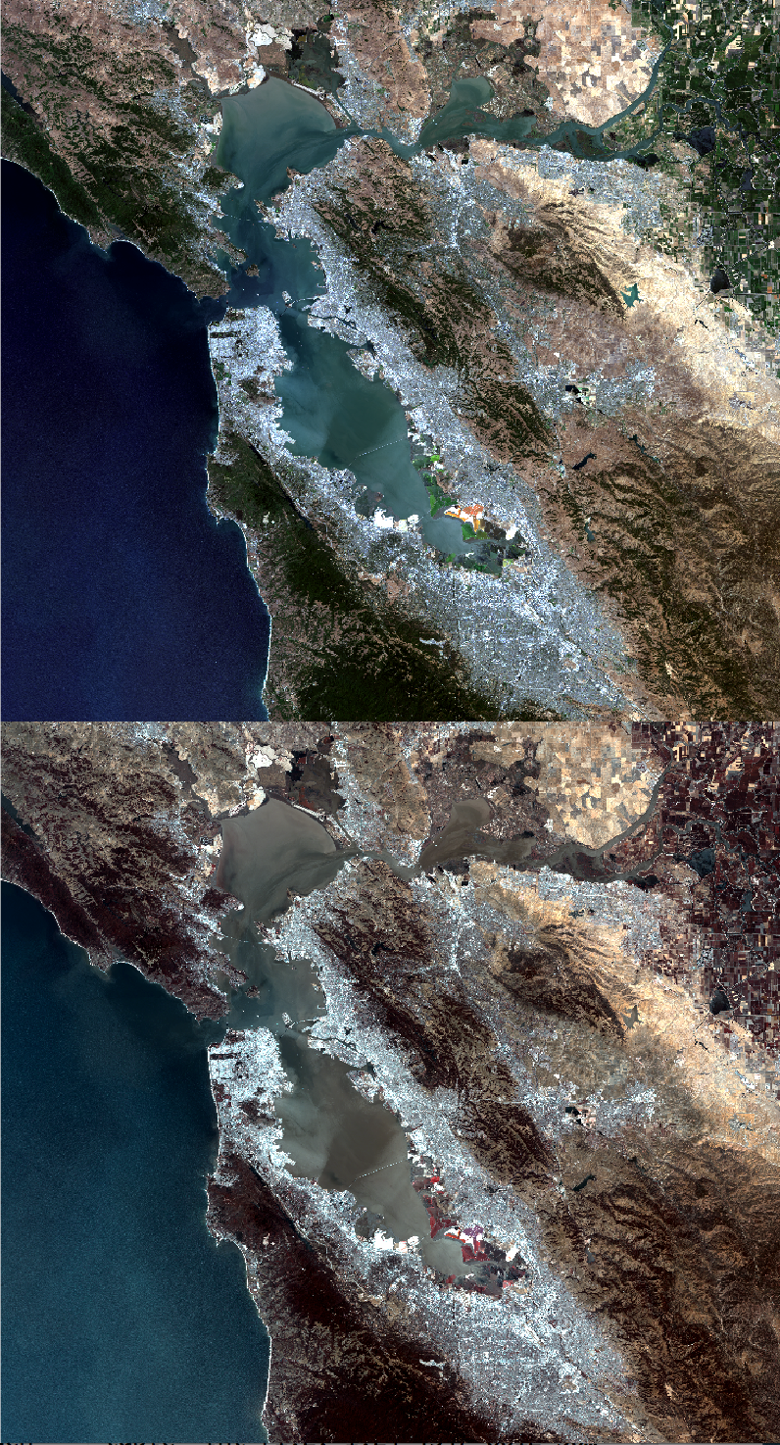
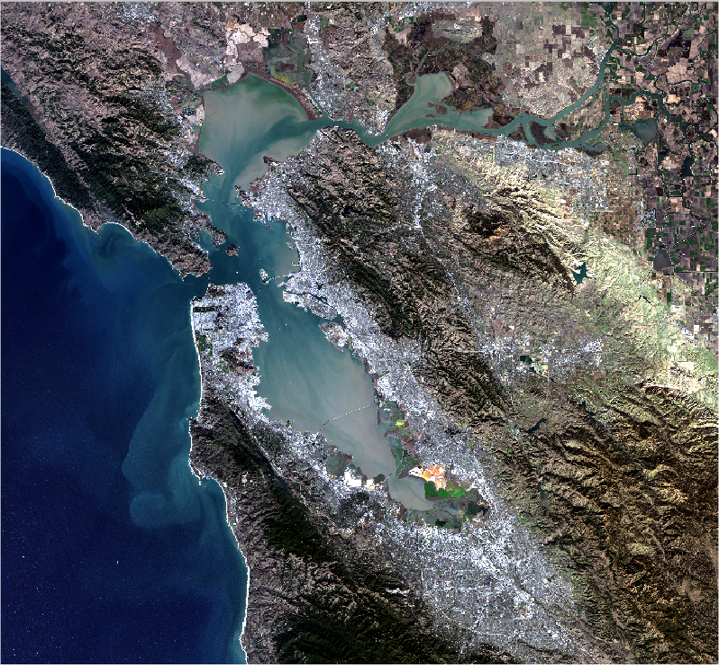
Compute coefficients for target and intercept that minimizes error in: target coefficient*target + intercept = base
Normalize through each band using linear regression
Target Image
Base Image
Mean radiance for Invariant Target:
Base Image: 0.1514348
Target Image: 0.2011686
Norm Image: 0.1596823
https://github.com/ylfeng93/Radiometric-Normalization-R
Normalized Image

